Slide 1

Marathwada Mitra Mandal's College of Engineering, Pune
Virtual try-on system for watches using augmented reality.
By
Ankita Bhikule (BC249)
Pooja Ganeshkar (BC251)
Kajol Kumbhar (BC256)
Prasad Nimse (BC258)
Under the guidance of
Ms. Swati Shekapure

Slide 2
Index
Introduction
Problem Definition
Related Works
System Architecture
Algorithm
Mathematical Model
Scope of the Project
References

Slide 3
Introduction
Title of the project: Trying Watches in Augmented Reality
Domain of the Project: Augmented reality
Augmented reality (AR) is an interactive experience of a real-world environment where the objects that reside in the real world are enhanced by computer-generated perceptual information, sometimes across multiple sensory modalities, including visual, auditory, haptic, somatosensory and olfactory.

Slide 4
Problem Definition
In earlier days people used to try watches physically which was very time consuming but now a days by sitting at home virtual try-on systems make it possible for buyers to see themselves wearing different watches without actually wearing the watches. Such system can improve the shopping experience by assisting customers to make purchase decisions.

Slide 5
Related works
Sr. No | Paper Title and year | References | Points
1 | TDTOS – T-shirt Design and Try-On System(2015) | Chen-Yu Hsu* , Chi-Hsien Yen* , Wei-Chiu Ma* , and Shao-Yi Chien Department of Electrical Engineering, National Taiwan University | Image Retrieving Memory Control
2 | Advertisement Using Augmented Reality(4 April 2018) | S.Sivasubramaniam1 ,V.Muthu Dinesh2 , Mrs.R.Ramya3 1,2,3 Computer Science and Engineering, Kamaraj College of Engineering and Technology,Tamil Nadu, India | Composite 3D object with target image
3 | Privacy Preserving Cloth Try-On Using Mobile Augmented Reality(2018) | Yoones A. Sekhavat, Assistant Professor in Faculty of Multimedia in Tabriz Islamic Art University | Model Selection and AR Rendering
4 | Virtual Mirror Real Time Tracking of Shoes in Augmented Reality Environments(2007) | Peter Eisert, Jurgen Rurainsky, Philipp Fechteler ¨ Fraunhofer Institute for Telecommunications, Heinrich-Hertz Institute Einsteinufer 37, D-10587 Berlin, Germany | Augmentation

Slide 6
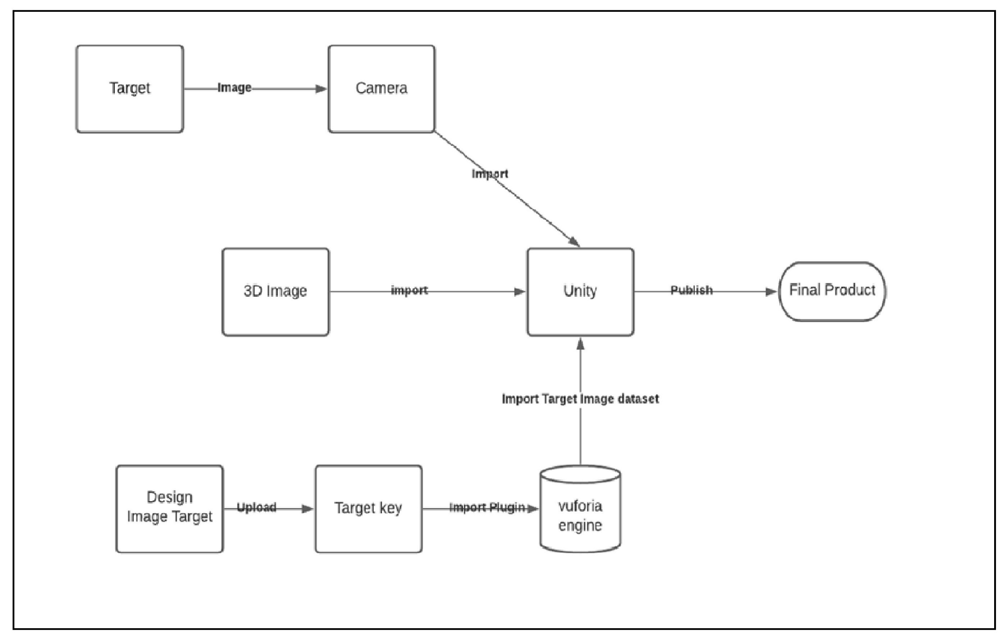
System Architecture

Slide 7
Proposed System(Algorithm)
Open or create a Unity project & Fixed target image,add in to GameObject
Then GameObject is upload in to Vuforia that it created a dataset provide a key this key assign to prefabs.
Prefabs it having 3d model that place in target image.
Create a C-sharps script, call it MyPrefabInstantiator, for instance, and attach it to the image target object.

Slide 8
Mathematical Model
Estimation Technique Used
    COCOMO (Constructive Cost Estimation Model) was proposed by Boehm [1981].COCOMO predicts the efforts and schedule of a software product based on size of the software. COCOMO stands for “Constructive Cost Model”. According to Boehm, software cost estimation should be done through three stages: Basic COCOMO, Intermediate COCOMO and Complete COCOMO
We are going to used Basic COCOMO that categorized projects into three types:
i. Organic: Suitable for organization that has considerable experience and requirements.
ii. Semidetached: Examples of this type are developing new database management system.
iii. Embedded: Organization has little experience and stringent requirements.
The Basic COCOMO formula takes the form:
E=a_{b} (KLOC)^{(b}_{b}⁾ [person-months]
D=c_{b} (E )^{(d}_{b}⁾ [months]
P= E / D [persons]

Slide 9
Coefficient values for Basic COCOMO
Software project | a_{b} | b_{b} | c_{b} | d_{b}
Organic | 2.4 | 1.05 | 2.5 | 0.38
Semi-detached | 3.0 | 1.12 | 2.5 | 0.35
Embedded | 3.6 | 1.20 | 2.5 | 0.32
Effort Estimation
The value a_{b} and b_{b} according to embedded system is
a_{b}=2.8 and b_{b}=1.20
The system falls in the embedded category.
Total LOC (approx) of project is:5000LOC=5.00KLOC
Effort (E) =a_{b}(KLOC)^{(b}_{b}⁾ [Person -Month]
E=3.6*(5.00)^{1.20}
E=24.83PM
Person-Month=25PM (approx)
Duration Estimation
Duration (D) = c_{b}(E )^{(d}_{b}⁾[months]
= 2.5*(24.83)^{0.32}
= 2.5 *2.7950
= 6.98
Duration ≈7 [months]

Slide 10
Person Required
Person Required = Effort Applied (E) / Development Time (D) [count]
= 24.83/7
= 3.64[count]
Person Required =4 [Persons]
Cost Estimation
We take the assumption four person charges 2500 rupees per month.
Total Estimation= 17,500*7= Rs.17,500/-
Total Estimation=Rs.17,500=17,500/-
Total Estimation=Rs.17,500 /-

Slide 11
Scope of the Project
Scope of this project can be extended further Like Amazon or another web application apart from watch we can build that application for multiple accessories which will get displayed into the 3d form and user can see how it looks and depending on that user can choose the accessories which will be helpful for the user.
Creating a iot compontets and performing a practical used a augmented reality those thinks are all ready working but it not eﬀectivly work in a future all those practical perform in augmented reality base application.
Creating human body models that allow medical students to learn anatomy in depth; Providing more training opportunities for medical students with the help of simulations; Practicing surgeries on virtual patients.

Slide 12
References
Chia-Chen Kuo National Center for High-performance Computing Hsinchu, Taiwan
S.Sivasubramaniam1 ,V.Muthu Dinesh2 , Mrs.R.Ramya3 1,2,3 Computer Science and Engineering, Kamaraj College of Engineering and Technology,Tamil Nadu, India
Fraunhofer Institute for Telecommunications, Heinrich-Hertz Institute Einsteinufer 37, D-10587 Berlin, Germany.
Yoones A. Sekhavat, Assistant Professor in Faculty of Multimedia in Tabriz Islamic Art University

